Slide 1

AWS Systems Operations 21 May 2019 Fernando Pombeiro

Slide 2
About DI
Founded in 2003; headquartered in Boulder, Colorado
Founder and CEO, Kelby Zorgdrager, has 20 years’ experience in Technical Learning and Development
More than 40,000 developers trained in 30 countries since 2003
Managed and delivered learning solutions to more than 4,000 developers globally in 2014
Over 200 different course offerings available in Open Source, Java development, web and mobile application development, cloud computing, and more

Slide 3




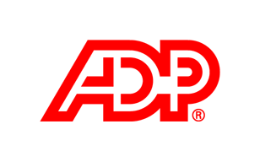
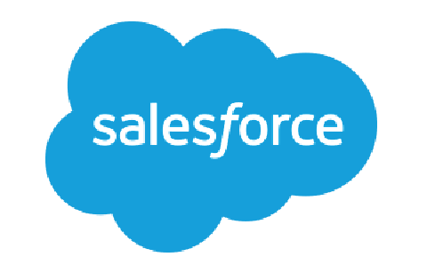
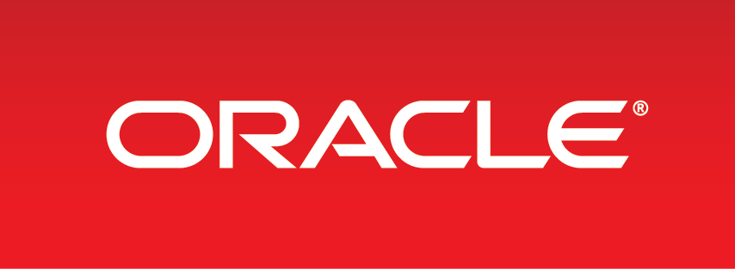
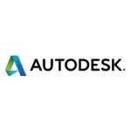








Our Customers Include

Slide 4
About the Instructor
Background: Six years military (two tours in Iraq) defusing mines followed by four years at Amazon.com in operations.
Transitioned to the gaming world in 2009 as a coder.
Been coding for ~ 10 years:
LAMP stack initially
Transitioned to Python, MongoDB, ELK and GOLANG
Working in coding naturally led to a move to DEVOPS- in startups- which is where I am now
Introductions!

Slide 5
About the AWS-Architecting Course
In this course we’ll be covering an introduction to AWS architecting.
Now- AWS offers upwards of 90 services to customers…so we will obviously not be going into deep dives on all of them (that’s all we would talk about and we want to be able to do some practical work!)
Our focus will be primarily on the commonly used parts of AWS to put up a robust, inexpensive, flexible architecture.

Slide 6
About the AWS Architect Course
The course will move between lectures and labs with the over-arching theme to create a single application.
As I am a movie fan this will have to do with bad films.

Slide 7
Class Schedule
Class schedule:
Pretty simple: Around 2.5 hours then 20 minute break broken into three parts:
Meet n’ greet: 9 – 9:30am
Lab Setup: 9:30 to 10:30am
Break: 10:30am to 10:45am
Lecture 1: 10:45am to 12:15pm
Lunch: 12:15 to 1:15pm
Lab 1: 1:15pm to 3:45pm
Break: 3:45pm – 4pm
Lecture 2: 4pm to 5:30pm
Questions & whatnot: after 5:30pm
Breaks:
As needed. Nothing formal (we’re all adults!) but one rule: PLEASE do not return to your workstations and start “doing email” or I will NEVER SEE YOU AGAIN!

Slide 8

Lab Setup (Please see LAB SETUP in Github)

Slide 9
Overview of the AWS system

Slide 10
Brief history around AWS
Original idea was around an initial beta released in 2002 (called the Amazon.com Web Service that offered SOAP and XML interfaces for the Amazon product catalogue.
In 2003, during an executive retreat at Jeff Bezos’ house, the Amazon leadership team was asked to identify the core strengths of the company.
What emerged from that was the infrastructure advantage that Amazon had over it’s competition.

Slide 11
Brief history of AWS (continued)
The initial AWS offering was launched on March 19, 2006 offering two services:
S3
EC2
(SQS followed soon after)
Elastic Block Store came after that
Then the Content Delivery Network known as Amazon Cloudfront
We will be using all of these

Slide 12
Cloud Computing
So basically- the rest is kind of history. The growth of AWS is, well:

Slide 13
AWS history (continued)

Slide 14
AWS Philosophy: Serverless
Obviously AWS continued to add services consistently in the years since. This has led to some some interesting consequences and coding philosophies. We’re going to go over some of those now as they will be extremely relevant in our upcoming modules.

Slide 15
AWS Services (categorized)

Slide 16
Serverless Philosophy
So as a consequence of all of these various services being created by AWS we have seen a plethora of applications adopting a serverless or microservices philosophy.
In layman’s terms this basically means that instead of depending on a monolithic server to run your application you break it down to smaller portions and let AWS manage those portions.

Slide 17
Microservices Advantages
So what is the advantage of utilizing a microservices architecture?
The follow the Single Responsibility principle
Resilient/Flexible (you can have a failure in one service without crashing the others)
Highly scalable
Easy to enhance (as you are dealing with less dependencies)
Low impact on other services
Easier to understand
Easier to Test each unit individually
Easier to deploy
Free to choose technology

Slide 18
Microservices Disadvantages
But there can be disadvantages, including:
Tougher to manage multiple deployments
Integrations between disparate services can have unexpected consequences
Integration testing can be painful
It quickly becomes an administrative nightmare managing the deployments of 10,000 pieces of separate code instead of one monolithic one.

Slide 19
Microservices as modern architecture
Overall microservices are the direction that the industry seems to be taking. Everything from DOCKER (self contained containers intended to wrap around a piece of code and do A thing) to utilizing AWS managed services point to this as the future of coding.
This should hopefully help with reducing the 3am calls to dev/ops when the servers go down.

Slide 20
Another consequence….
Another consequence of the modern ”serverless” architecture is increased complexity.
In some ways it’s nice not to have to worry about a single server…but what you’ve traded that off for (in the dev/ops world) is that you now have to worry about 50 servers…in the form of microservices.
How can we make it easier for the dev/ops team to manage multiple servers?

Slide 21
Our first Microservice tools foray
So when we get to lab one we’re going to be using Docker- which is a big part of the microservices architecture.
We’re using Docker because it’s kind of a cheap way for us to get virtual machines without the overhead of installing something like Vagrant and iso images
Think of Docker (in the context of this class) as a VM intended to get everyone onto the same OS.

Slide 22
Docker
The easiest way to summarize docker is that you build the server around the code instead of moving the code into a server.
This makes your server environments super easy to replicate, manage, and pass to your entire team.
It also means (in the context of this class) that we have a way to make sure that all of us are on the same OS instead of worrying that half of us are following WINDOWS and the other half MAC.

Slide 23
The Dockerfile
So the Dockerfile is sort of an all-in-one provisioning document that allows us to set up and execute a “VM” (I put that in quotes because big fans of docker insist that it’s not a vm!! Even though I’m totally using it here as a VM).
Anyways- Dockerfiles allow us to install all of the dependencies and packages in our “docker image” which is then instantiated as a “docker container” (which is totally a VM….fight me).

Slide 24
Docker Images and Containers
Understanding the difference between images and containers is kind of the key to understanding DOCKER. If you’ve ever done Object Oriented Programming you’ll understand this concept easily as IMAGES are the classes and CONTAINERS are the instantiated OBJECTS.

Slide 25
Docker Images and Containers (con’t)
So the idea here is that the Dockerfile builds an image. This image acts as the blueprint for the container that we build.
In the broader context of microservices architecture DOCKER containers can act as small VMs that contain a single piece of code and execute it.
We can have separate Docker containers for different functions in the app.

Slide 26
Final Note On Docker
A deep dive of Docker is outside of the scope of this class BUT…as we will be utilizing it extensively to ensure that everyone is on the same OS it’s good to get a high level overview.
If you don’t use docker regularly in your microservices architecture then you’re missing out. AWS has great services known as Fargate and ECS that act as repositories for docker containers. We’ll get into these a bit later.

Slide 27
Infrastructure as code
So it would be nice if we could list all of the assets that we need to provision, wire them all together, upload our code to them, and get everything running.
Fortunately…thanks to the wonders of the modern technology…we CAN do exactly that.
To do this we will be using terraform.

Slide 28
Introduction to Terraform
So…think of terraform as a list of assets that you’ll need in order to run your application. Like- you need:
Somewhere to store your data
Somewhere to present your data
Middleware
Code repository√
There are AWS services that basically do ALL of these things SO- with Terraform we list them and can run them.
BUT WAIT….there’s more!!

Slide 29
Why Terraform?
So there are several companies doing things similar to Terraform…including serverless and cloudformation…BUT- terraform has one big advantage:
It can work across platforms
So if a meteor takes out all of AWS you can move everything and move it to GCP without making a WHOLE lot of changes.
Also can work on Linode, Openstack, and Azure

Slide 30
So what does Terraform actually DO?
So essentially you are able to manage most cloud platforms from your command line pretty easily (we’ll be setting all of that up in the first lab shortly).
You might use your CLI to say “create an EC2 server, an S3 bucket, a DynamoDB table, and a Lambda in the US-West-2 region”. You enter those commands and then move on.
Think of Terraform as the place you save those commands.

Slide 31
Terraform: More information
So the other advantages of Terraform is that it not only builds your infrastructure but also changes and versions it appropriately.
This gives you a lot of the same advantages you get from a coding repository- like rollbacks and diffs to let you see everything that’s being changed.
Think of things like puppet, chef, and ansible for provisioning servers.

Slide 32
Terraform (continued)
Every Terraform process is broken down into three separate and distinct parts:

Slide 33
Users and Permissions
In this first lab we’re going to be setting up users and permissions…which will play a large part in your job as dev ops over any AWS environment.
The first thing to understand about users is a similar rule to provisioning any sort of node; avoid giving root access to people if possible.
Just like with nodes you provision or production/dev/staging nodes you have in existence: create users with permissions to do what they need to and then stop.

Slide 34
Users, Roles, Groups
So understanding the Identity and Access Management system in AWS mostly concerns three concepts…which we’ll be going over here:
USERS: This is the entity that you create in the IAM management console that represents an individual
GROUPS: This is a collection of IAM USERS. You would use GROUPS to grant/demove permissions for multiple users at the same time (think “HR” or “DEVS” or “ACCOUNTING”)
ROLES: Roles are a set of permissions that can be assumed by USERS or GROUPS (of users) that give access to AWS functions.

Slide 35
Users, Roles, Groups
It’s been my experience that when you have issues with something in your AWS architecture- be it nodes failing to communicate or something failing to put/pull data from a source it is either permissions or VPC related.
It will be tempting to give max permissions and roles to every “user” that assumes a role to reduce errors. Avoid the temptation to do this.

Slide 36
Temporary Credentials
With IAM you can also assign temporary credentials to an entity (or user) to “assume” a role in order to carry out an operation.
You can set temporary credentials to expire after a set period of time allowing for better security around certain roles. We’ll go over some of this in the labs.

Slide 37
Using IAM roles to grant permissions
So ROLES are nice because you aren’t limited to only assigning them to USERS; you can also assign them to things like EC2 instances.
As an example- if I have a Lambda function that reads data from an s3 bucket and puts that data into Redshift via a kinesis stream we can simply assign the lambda a ROLE that gives s3, kinesis, and Redshift permissions while it runs.

Slide 38
IAM setup (final thoughts)
For this class we are going to use our AWS ROOT role to set up users to provision and run various parts of the architecture.
The main thing that we’ll need to get from creating the user is the AWS_ACCESS_KEY and AWS_SECRET_ACCESS_KEY for our users.
Managing these keys is another challenge that we’ll be going over in labs once docker and everything else is up and running.

Slide 39
Policies
The final level to setting up users is to set policies which can be assumed by ROLES.
Policies define AWS permissions assigned to a user, group OR profile. They are represented by collections of JSON that list the particular service and permissions attached to it.
You can apply these policies in various ways- including granting limited access to certain AWS resources (like EC2 instances or a DynamoDB Table).

Slide 40
Policies (continued)

Slide 41
Policies
Unique AWS resources can have their own policies attached to them and you can assign policies to a particular user to, for example, access EC2 instance 123 but never to access EC2 instance 456.
Policies are a key component of allowing AWS resources to talk to each other…so for example you might have a Lambda function that wants to put things in an S3 bucket.
In order to do this the role assumed by the Lambda function must have a policy that allows it to PUT into an s3 bucket.

Slide 42
Policy documents in JSON

Slide 43
Different types of policies
Identity Based Policies:
Basic policy- attached to IAM identities (users , groups and roles) that grant permissions to do things.
Resource Based Policies:
The policies attached to resources– think of the s3 bucket example as that’s a resource based policy.
Permissions boundaries:
These are policies that limit permissions to a user or role…so “Jack can never have permission to PUT into an s3 bucket”/
Organization Service Control Policies:
If you have a large organization you can set policies to define max permissions for all account belonging to an organizational unit (say accounting or HR)

Slide 44
Different Types of Policies
Access Control Lists
The only non-JSON based structures these are cross-accounts permissions policies that grant permissions to a principle entity.
Session Policies:
“While logged in you can do X…but will expire at end of session”.

Slide 45
Describing AWS resources
So now that we have been over IAM policies we need to address how AWS understands resources.
Every resource in AWS is identified by an ARN or Amazon Resource Name.
The ARN is an AWS service namespace that describes a resource unambiguously.
Basically- it’s AWS’ name for all of the cool stuff that you are creating.

Slide 46
ARNs
The basic format for an arn is as follows:
arn:partition:service:region:account-id:resourcetype/resource
And the various parts are made up as follows:
partition: unless you are in, like, China the partition will always be aws.
service: the aws service that we are using- for example S3, IAM, RDS
region: the standard aws regions (eu-west-1, eu-west-2, us-west-1, etc)
account: the account id of the account that owns the resource.
resource: usually the resource and a unique identifier

Slide 47
ARNS examples
So, for example, for DynamoDB we might see an ARN that looks like this:
arn:aws:dynamodb:us-east-1:123456789012:table/books_table
And for Lambda we might see something like this:
arn:aws:lambda:us-east-1:123456789012:function:ProcessKinesisRecords

Slide 48
We’ll be using ARNs to describe stuff
ARNs are how we describe resources and anything we’d like to DO to those resources TO AWS via the command line
ARNs can have specific policies attached to them (s3 bucket arns) and we can create policies for users that apply only to certain ARNs (Jack can access the ARN that controls our EC2 instance but does not have permissions to access any other ones)

Slide 49
AWS Secret Access Keys
Each user will come with a set of keys- an ACCESS key and a SECRET key. We want to store these in places that are easily accessible and allow us to easily use the AWS command line.
There are several options for key management with AWS. We’re going to do two of them here- set them up locally (we’ll do that in the lab) and set them up our Docker containers (as Environment variables).

Slide 50
Access Keys
This part is important for security: do not put your secret or access keys in any sort of git repository.
Do not let your developers put keys anywhere public
What does this mean? Basically…
If you are using keys locally from a file, add them to your .gitignore
If you need them as environment variables or to pass them as ARGs to a docker container…same rule read them or make them ENV variables on the host.
Do not ever, ever expose these.

Slide 51
Final Note on Access Keys
Access key management is one of those areas that there is no “right” answer for.
We’re using Docker for this class and will be utilizing the “make your access keys environment variables” technique to manage our keys…but this is far from the only option available to us.
Credentials files and profiles are also incredibly effective for key management.

Slide 52
Access Keys (best practices)
My suggestion would be that you, as the devops team, keep copies of every set of access keys that you grant alongside of every user ID. This can come in handy if you have to update the keys (should be obvious how to do this) and if a user loses them.
Upon a developer leaving you should remember to go to the IAM console and remove their access as soon as possible- including the keys.

Slide 53
Confused????
GOOD! Ask Questions!!

